Slide 1
A credit card fraud detection
Prajwal Bangarapu Chakravartula Nagendar Kushal Shendge Mohammed Abdallah

Slide 2

Introduction
Credit card fraud is a major global issue, leading to significant financial losses.
Machine Learning can help detect fraud by identifying suspicious transaction patterns.
This project utilizes a Linear Regression Model and PCA-transformed data to identify fraudulent transactions efficiently.

Slide 3
Problem Statement
Credit card fraud remains a pressing issue, causing significant financial losses and impacting consumer trust. Detecting fraudulent transactions in a vast and complex dataset is challenging due to the imbalanced nature of the data and the need for real-time analysis. This project aims to develop an effective machine learning model using PCA-transformed features and linear regression to accurately identify and prevent fraudulent transactions while preserving user privacy.

Slide 4
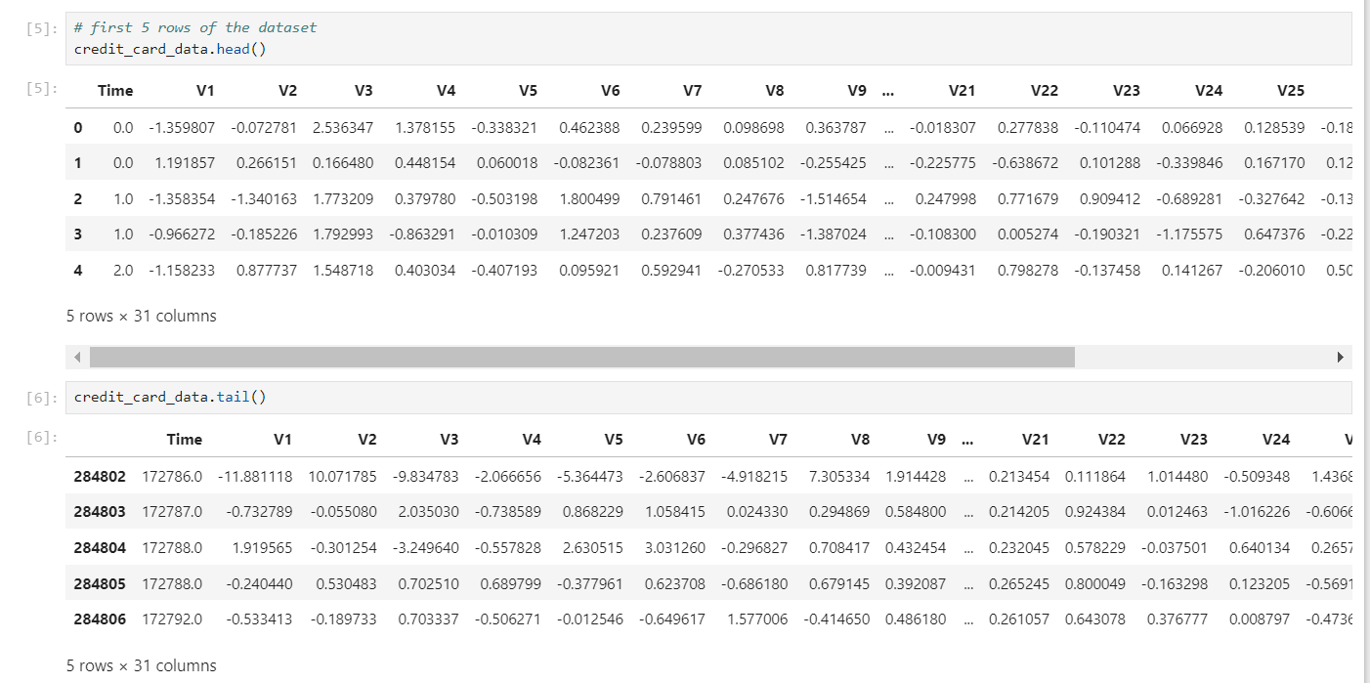
Dataset overview
The dataset contains 284,807 transactions, with 492 fraud cases (~0.17% fraud rate).
Features V1 to V28 are anonymized, and derived through PCA to protect sensitive information.
The dataset includes key columns:
Amount: Transaction value.
Class: Binary indicator (1 = Fraud, 0 = Legitimate).
Data imbalance: Fraudulent transactions make up a tiny percentage, requiring special techniques like oversampling/undersampling to handle the imbalance.

Slide 5
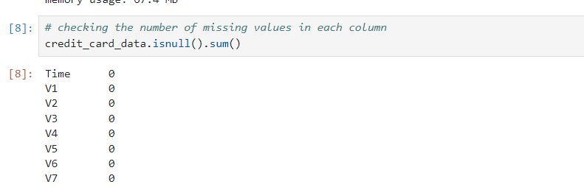
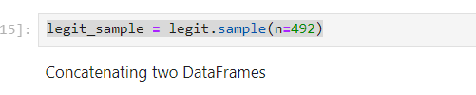
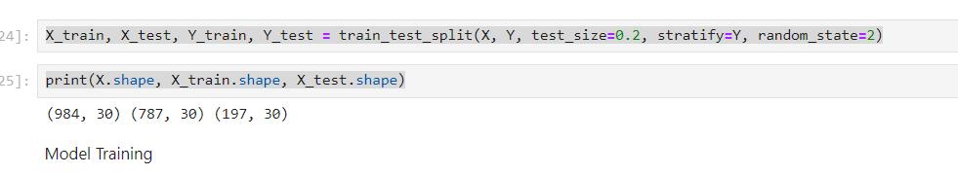
Data Preprocessing
Checked for Missing Values: Confirmed that no columns had missing data.
Class Imbalance: Legitimate transactions significantly outnumber fraudulent ones.
Example: Legitimate (Class 0) vs Fraud (Class 1)
Balanced Dataset: To avoid bias, sampled equal numbers of legitimate and fraud transactions (492 each).
Train-Test Split: Split into 80% training and 20% testing using stratified sampling to preserve the balance

Slide 6
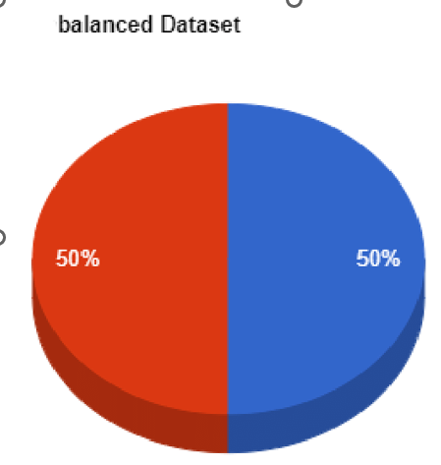
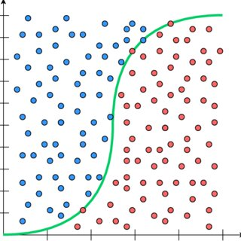
Model Selection
Logistic Regression: Chose logistic regression for classification.
Reason: Simple and effective for binary classification problems like fraud detection.
Model Training: Trained the model on the balanced dataset.

Slide 7
Model Performance
Training Data Accuracy: Model accuracy on the training set.
Test Data Accuracy: Evaluated accuracy on the test set to assess performance.
Accuracy Scores:
Training Accuracy:
Test Accuracy:

Slide 8
Conclusion:
Model accuracy: X% on test data.
Logistic regression identified fraud effectively.
Challenges:
Imbalanced data was a key challenge.
Future Work:
Explore advanced models (e.g., Random Forest, XGBoost).
Address data imbalance using SMOTE."

Slide 9
THANK YOU

